Slide 1


Building Codes & the Smart City
Ryan Colker
Vice-President, Innovation
Executive Director, Alliance for National & Community Resilience

Slide 2
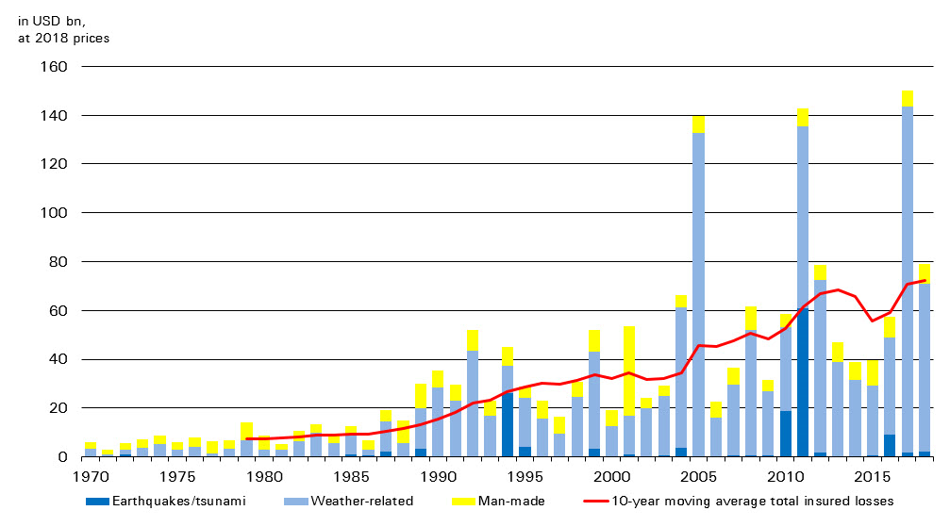
The Rising Global Impact of Disasters
https://www.swissre.com/media/news-releases/nr_20181218_sigma_estimates_for_2018.html

Slide 3
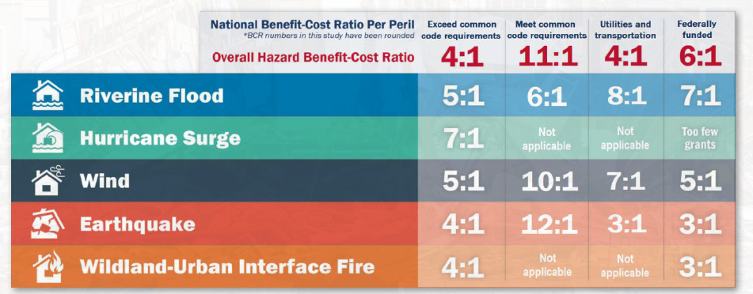
Building Codes Provide A Strong Benefit
Multihazard Mitigation Council (2018). Natural Hazard Mitigation Saves: 2018 Interim Report. Principal Investigator Porter, K.; co-Principal Investigators Scawthorn, C.; Huyck, C.; Investigators: Eguchi, R., Hu, Z.; Reeder, A; Schneider, P., Director, MMC. National Institute of Building Sciences, Washington, D.C. www.nibs.org

Slide 4
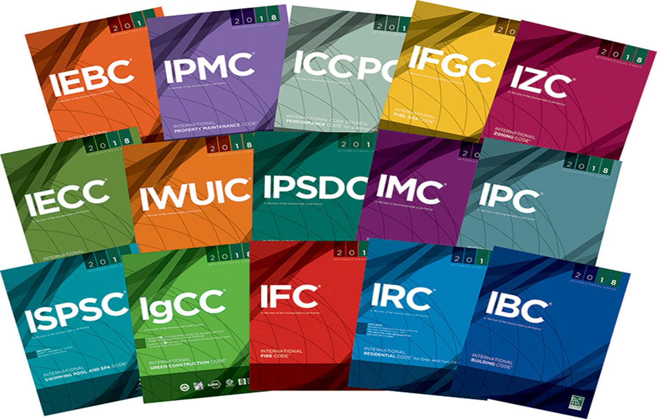
The Family of Model Codes
International Building Code (IBC)
International Fire Code (IFC)
International Mechanical Code (IMC)
International Plumbing Code (IPC)
International Residential Code (IRC)
International Energy Conservation Code (IECC)
International Existing Building Code (IEBC)
International Fuel Gas Code (IFGC)
International Property Maintenance Code (IPMC)
International Private Sewage Disposal Code (IPSDC)
International Zoning Code (IZC)
International Wildland-Urban Interface Code (IWUIC)
ICC Performance Code (ICCPC)
International Green Construction Code (IgCC)
International Swimming Pool and Spa Code (ISPSC)

Slide 5
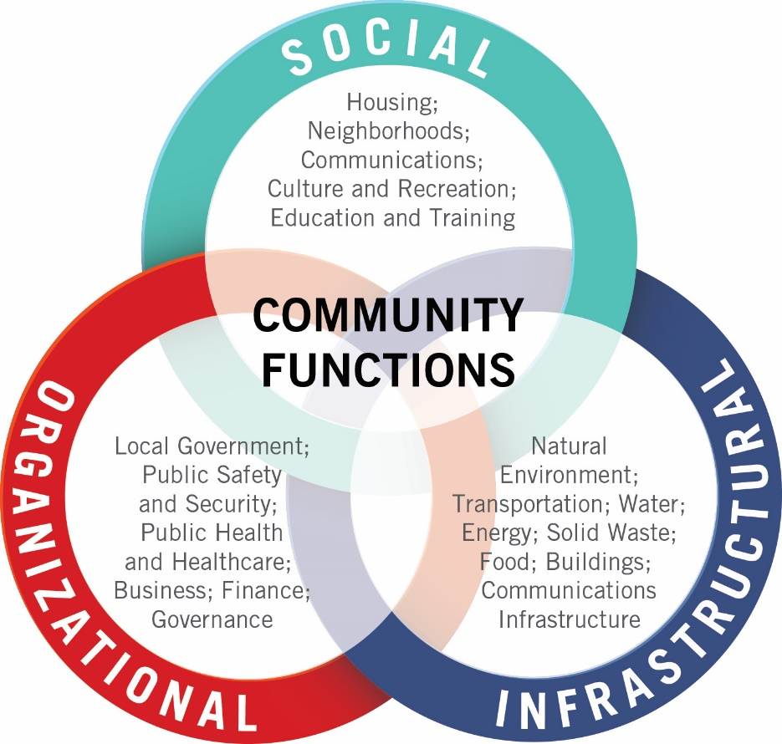
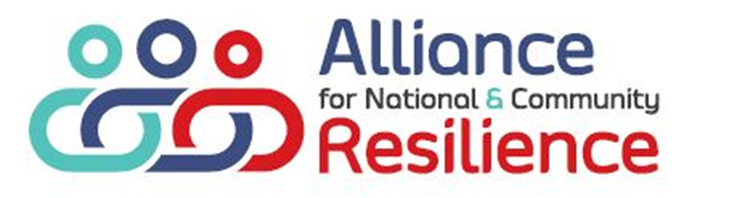
What Makes a City?

Slide 6

Building Codes & the Smart City
Interoperability
Energy/Water Efficiency/Management
Building to Grid
Emergency Management
Emergency Response
Hazard Mitigation
Communications
Planning
Finance/Insurance
Inspection
Customer Service

Slide 7
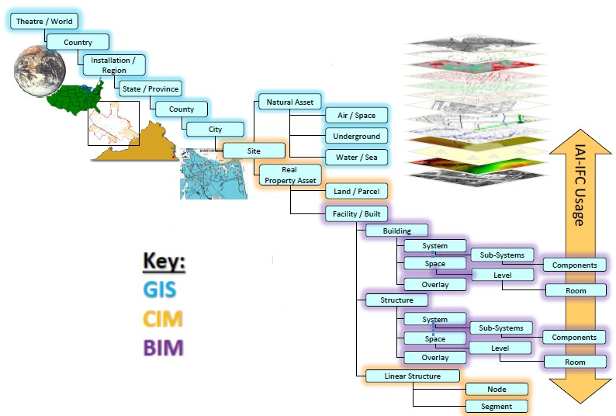

Slide 8



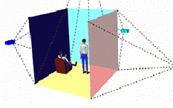
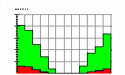


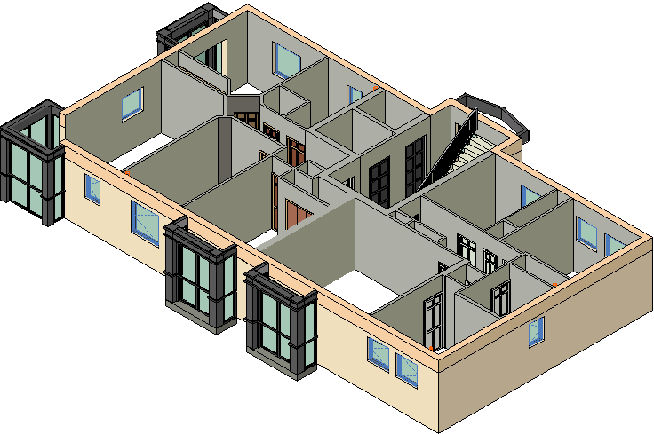
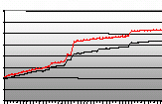










Laws and regulations
-Building regulations
-Building specifications
Design and Analysis
-Drawings, calculations
-Architect, engineer,…
Knowledge databases
-Best practise knowledge
-Own practice
Modeling
-Visualisation, 3D models
Simulations
-Comfort
-Ventilation, heating
-Energy
-Light, sound
-Insulation
-Fire, usage
-Environment
-Life time predictions
-Crowd behavior
- Safety
Briefing
-Functional req.
-Estimates
-Conditions
-Requirements
Building Information Model
Demolition, refurbishment
-Rebuild
-Demolition
-Restoration
Costing
- Initial cost
- Life-cycle
- Value Engineering
Facility management
-Letting, sale, operations
-Maintenance
-Guaranties
Specifications
-Specification sheets
-Classification standards
-Estimates, accounting
Construction management
-Scheduling
-Logistics, 4D
Procurement
-Product databases
-Price databases
By Lars Bjørkhaug
Illustrations by: Byggforsk, Olof Granlund, NBLN University of California, Stanford University
RMC Q4
Notes:
8
While we see BIM enabling numerous activities across the building life-cycle, I would point to a couple areas where homebuilders are probably best positioned at this time to implement BIM (as mentioned earlier, some of this is already occurring, but in separate, unrelated processes)
8

Slide 9
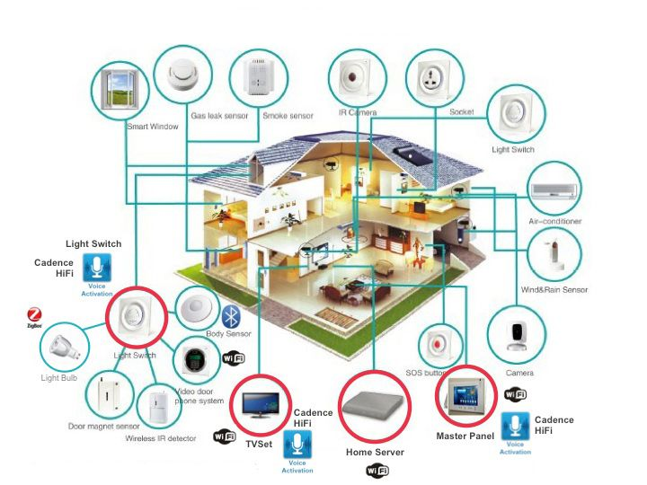
Sensors, Controls & IoT

Slide 10
Building Codes & the Smart City
Ryan M. Colker, J.D.
Vice President, Innovation
Executive Director, Alliance for National & Community Resilience
202-370-1800x6257
rcolker@iccsafe.org • ANCR@resilientalliance.org
iccsafe.org • resilientalliance.org
@rmcolker • @ANCResilience

